Slide 1
LEVEL 4/5 GROUP 10
THOMAS MCLAREN
JAMIE OWERS
EDUARD IABLONSCHI
EDWARD PHILLIPS

Slide 2
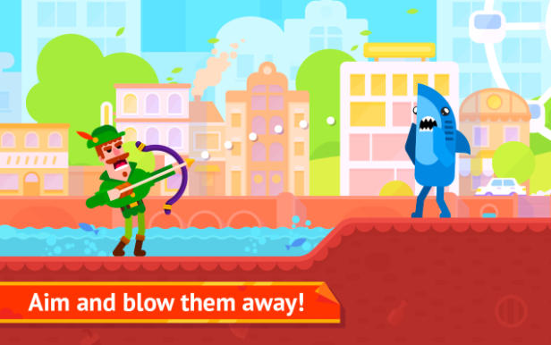
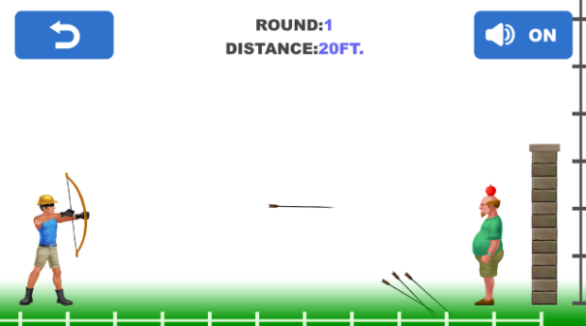
GENRE / STYLE
2D Action game
Mobile only
Competitive 2 player
Notes:
Tom McLaren slide

Slide 3
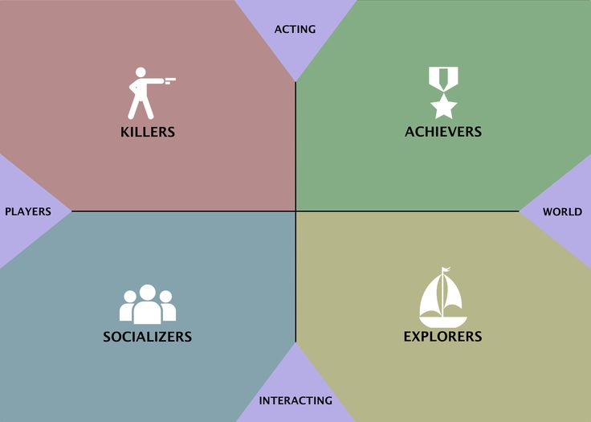
TARGET DEMOGRAPHIC
Socializers
+ Killers
Age:
12+
Gender:
Males & females
Notes:
Jamie Owers Slide

Slide 4
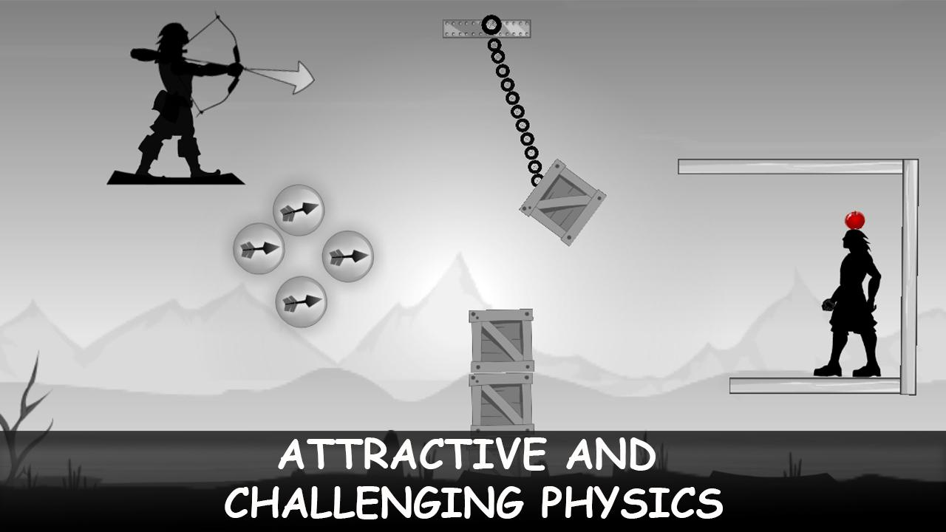
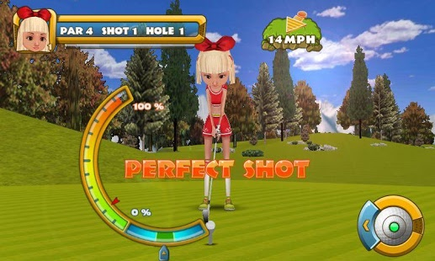
MECHANICS
Symmetric mechanic – Aiming & power selection
Damage – (hit by projectile)
Health bar
Notes:
Eduard Iablonschi Slide

Slide 5
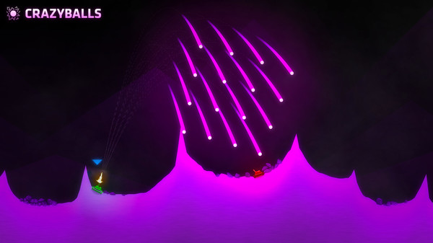
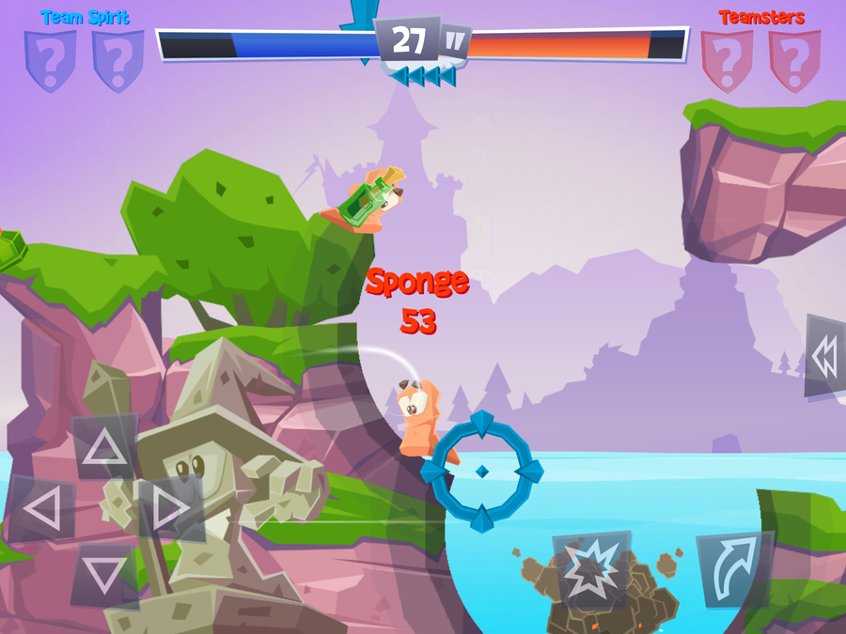
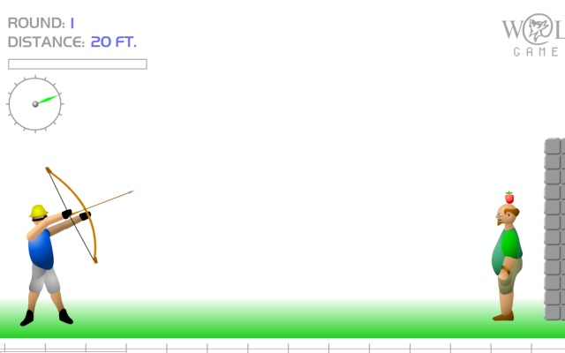
Inspired Examples
ShellShock Live
Shoot The Apple
Worms
Notes:
Tom McLaren Slide

Slide 6
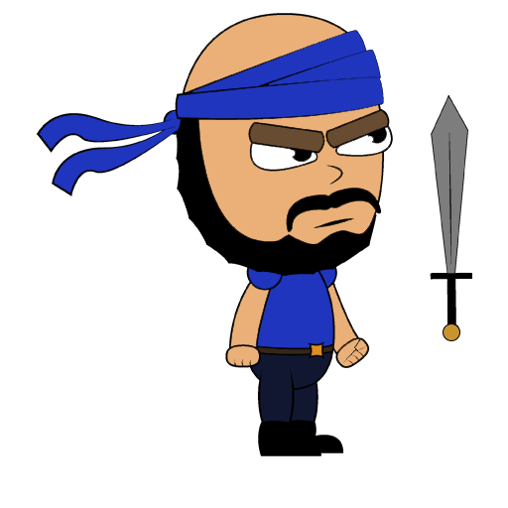
WHAT DOES THE PLAYER DO?
Button press
Competitive - goal
Reflex - selecting trajectory & power
Fiero
Notes:
Tom McLaren Slide

Slide 8



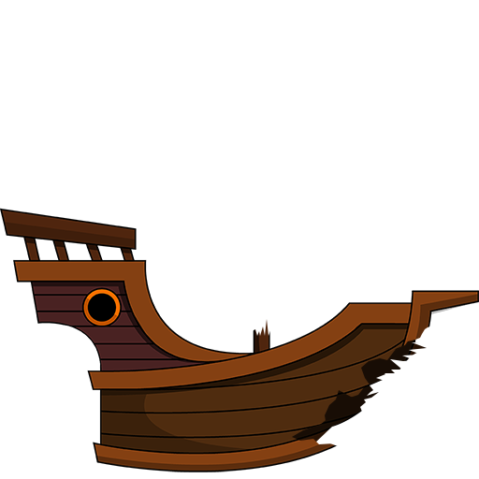

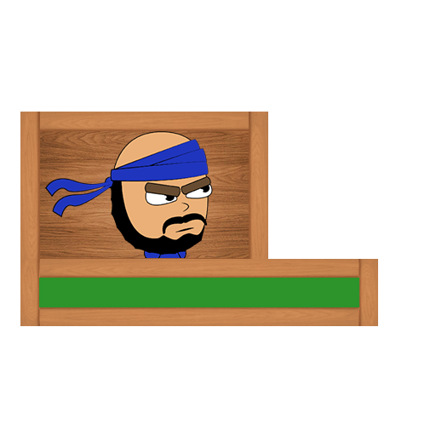
ART STYLE
Notes:
Edward Phillips Slide

Slide 9
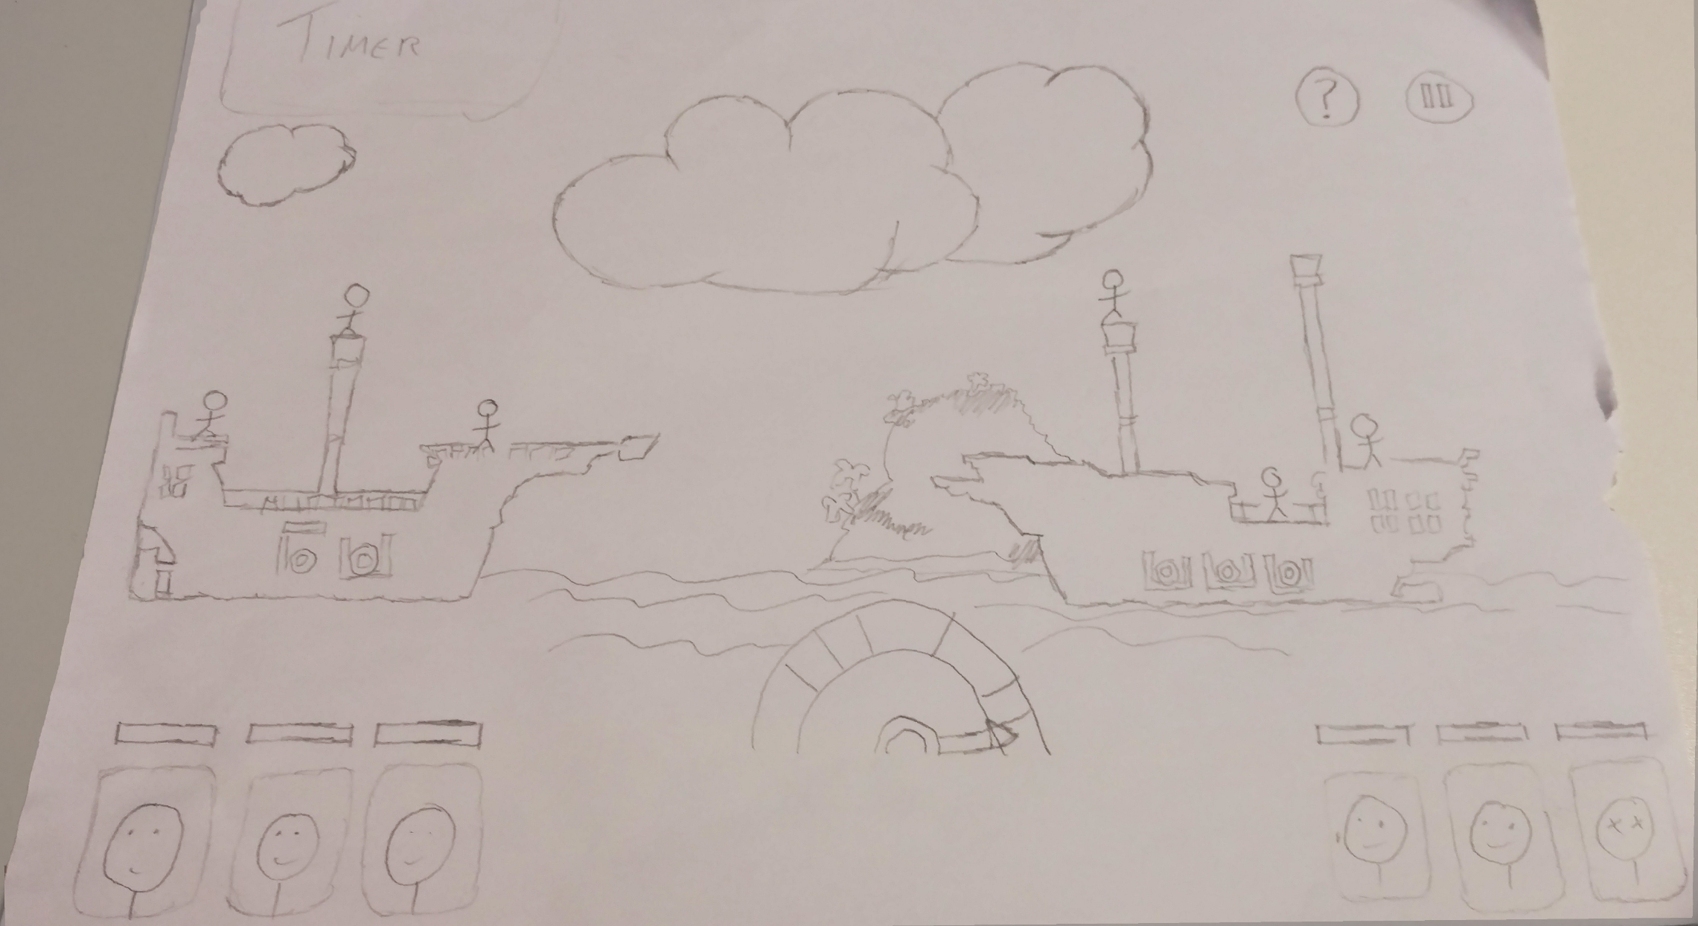
VISUAL HIERARCHY
Notes:
Tom McLaren Slide

Slide 10
PROTOTYPE

Slide 11
TARGETS FOR NEXT WEEK
Implement a distance gauge for players to see how far away the enemy is
Develop a difficulty power up, which causes the opponents ship to rock
Now with a working prototype, begin playtesting

Slide 12

ANY QUESTIONS?

